Slide 1

Attrition Case Study
Yvan C Sojdehei

Slide 2
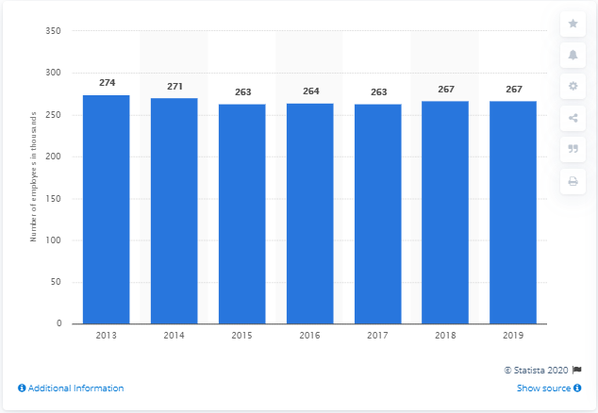
Goals
Create Model to Predict Attrition Rates and Analyze Results
Create Regression Model to Predict Monthly Salary and Analyze Results
- Presentation Data Taken From Public 3rd Party

Slide 3

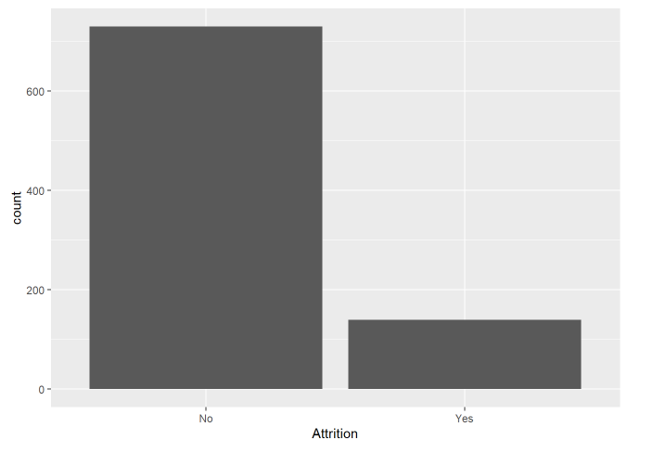
Overall Attrition
Take Away:
Attrition Is At About 16 Percent The Overall Employee Pool

Slide 4
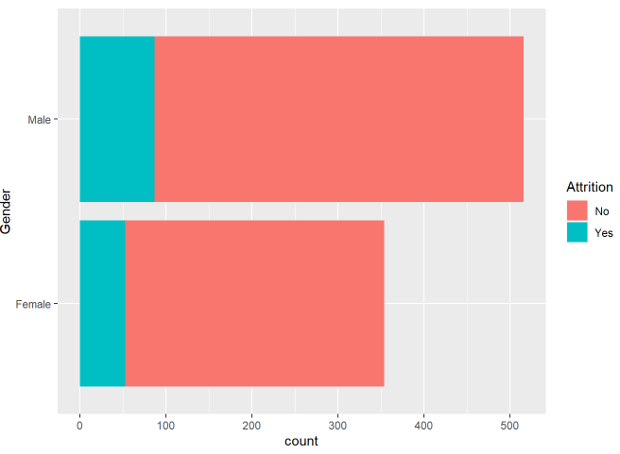
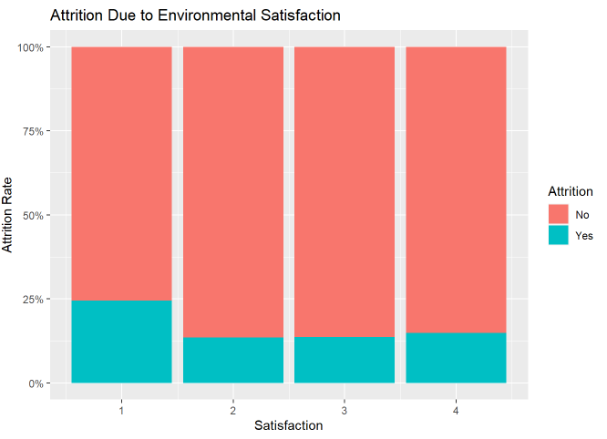
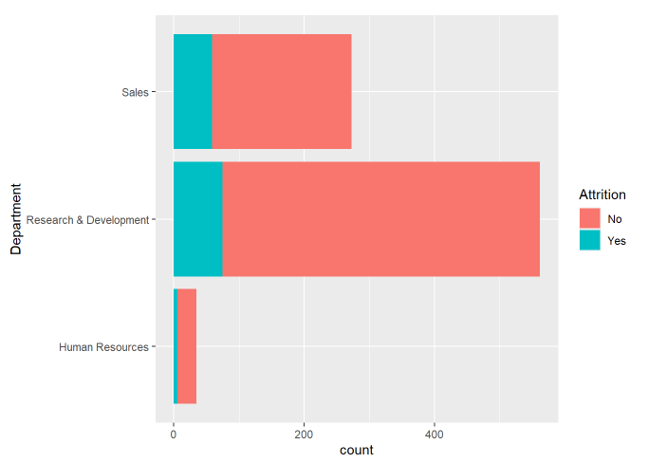
Data Visualization and Exploration

Slide 5
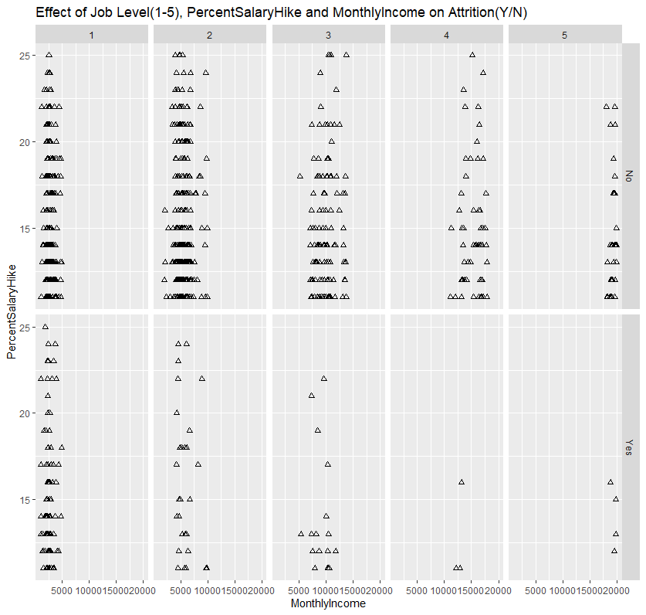
Further Exploration

Slide 6
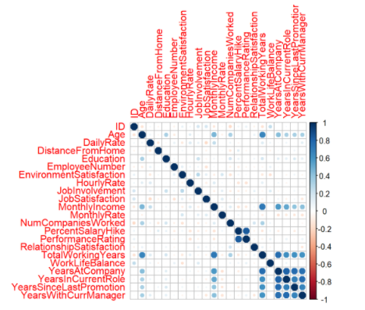
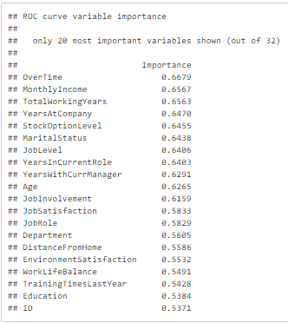
From Visualizing the Data, The Question Arises Of How We Can Begin to Determine Factors That Contribute The Most To Attrition?
Analyzing Both The Visualization and Vectorization Of All Variables

Slide 7
Create An Attrition Classifier
After analyzing the topmost contributors towards Attrition, we can commence the creation of am classification model to determine attrition.
We utilized a Naïve Bayes classification model and trained it to predict attrition.
The model will be trained against the full test dataset, then utilized to make predictions on data that has no attrition identifier.
Results: Avg Accuracy Avg Sensitivity Avg Specificity
0.8286697 0.8719328 0.6083380

Slide 8
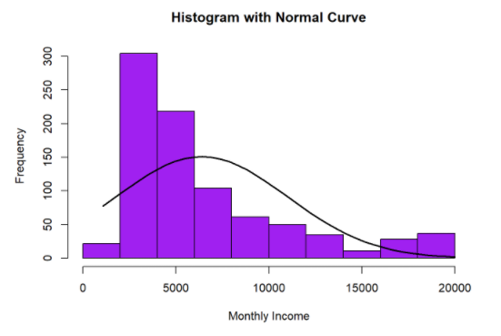
Create Regression Model to predict employee monthly Salary
We’re also interested in a method for predicting the monthly salary of employees.
This can be achieved utilizing a Multiple Linear Regression model trained to predict salary.
The model will be trained against the full test dataset, then utilized to make predictions on data with no income identifier.
Results: RMSE: $1020 RSquared: 0.95

Slide 9
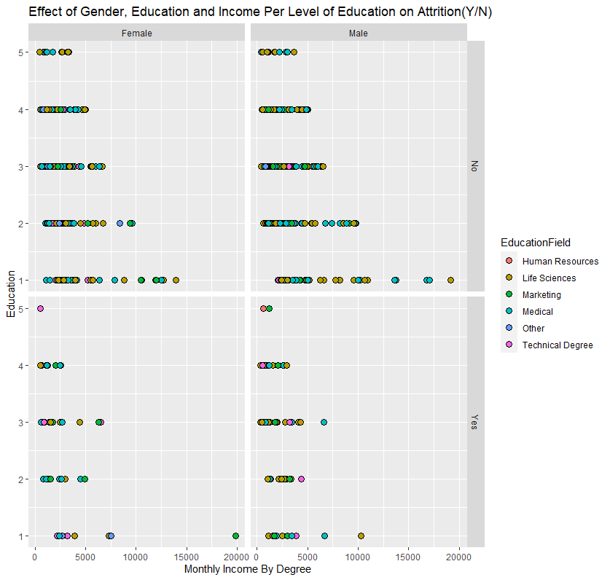
Additional Analysis
Here we measure the effects of Gender, Education, and Income as it pertains to level of education against attrition.

Slide 10
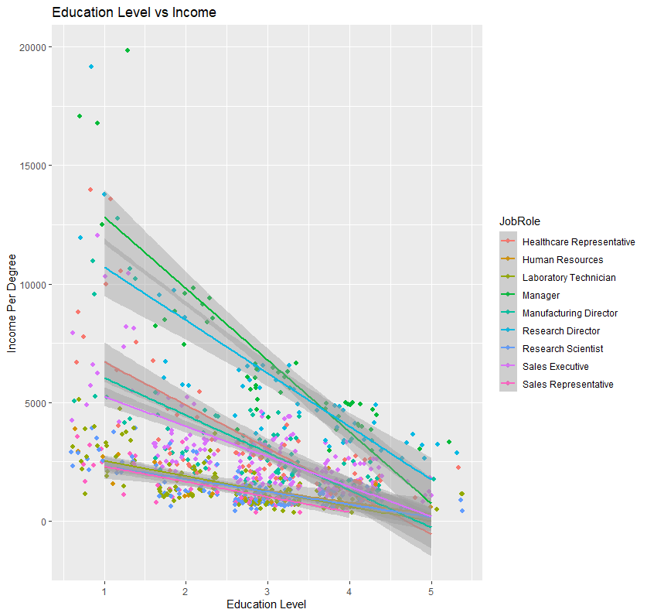
Additional Analysis
Here we have a similar analysis only this time we are determining the affects of Education Level vs Income against job role. As you can see there is a downward slope as income level starts to decrease.

